Slide 1
Al-Farabi Kazakh National University
Higher School of Medicine Department of Fundamental Medicine
Introduction to molecular biology. Part I
Lecturer: PhD Pinsky Ilya Vladimirovich
Notes:
Weaver, PART I

Slide 2
LEARNING OUTCOMES As a result of the lesson you will be able to:
describe the Chargaff, Griffith, Avery-MacLeod-McCarty, Hershey-Chase experiments and explain their significance;
explain informational properties of macromolecules;
explain the central dogma of molecular biology;
briefly discuss the role of molecular biology in medicine.
describe, identify, and draw the components of nucleosides and nucleotides
describe and identify nucleic acid chains in DNA and RNA

Slide 3
Molecular biology
Definition: the study of genetic structure and functions at the molecular level (the science about structure and functions of nucleic acids – DNA and RNA).

Slide 4
Readings: Russell, pp. 9-14; Hartwell, pp. 163-168; Watson, pp. 21-33; McMurry, pp. 814-823; Raymond, pp. 498-515.

Slide 5
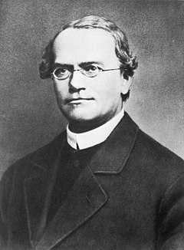
Gregor Mendel (1865)
Gregor Mendel conducted his experiments with peas showing that heredity is transmitted in discrete units. He pollinated plants by himself until they bred true – giving rise to similar characteristics generation after generation. He studied easily distinguishable characteristics like the color and texture of the peas, the color of the pea pods and flowers, and the height of the plants.

Slide 7
Thomas Morgan (1910)
In 1910, Thomas Hunt Morgan performed an experiment at Columbia University, that helped identify the role that chromosomes play in heredity. Morgan was breeding the Drosophila, or fruit flies. After observing thousands of fruit fly offspring with red eyes, he obtained one that had white eyes. Morgan began breeding the white-eyed mutant fly and found that in one generation of flies, the trait was only present in males. Through more breeding analysis, Morgan found that the genetic factor controlling eye color in the flies was on the same chromosome that determined sex. That result indicated that eye color and sex were both tied to chromosomes and helped Morgan establish that chromosomes carry the genes that allow offspring to inherit traits from their parents.

Slide 8
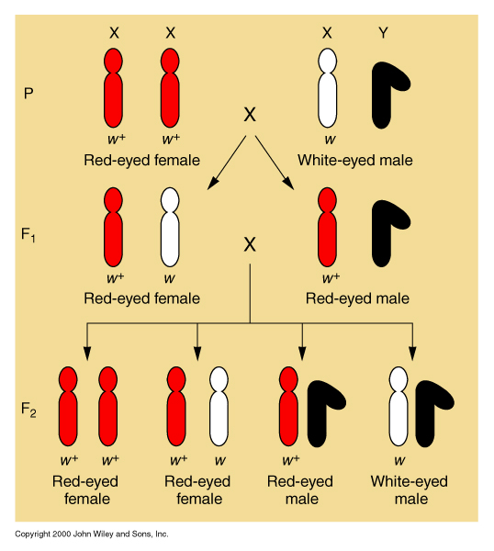
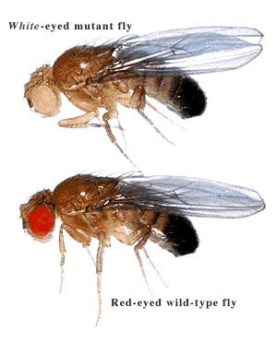
Chromosomal theory of inheritance

Slide 9
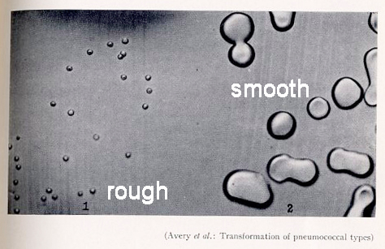
Frederick Griffith (1928): the transforming principle
Griffith used two strains of Streptococcus pneumoniae. These bacteria infect mice, Griffith's favorite animals. He used a type III-S (smooth) and type II-R (rough) strain.
The III-S strain covers itself with a polysaccharide capsule that protects it from the host's immune system. This means that the host will die.
The II-R strain does not have that protective shield around it and is killed by the host's immune system.

Slide 10
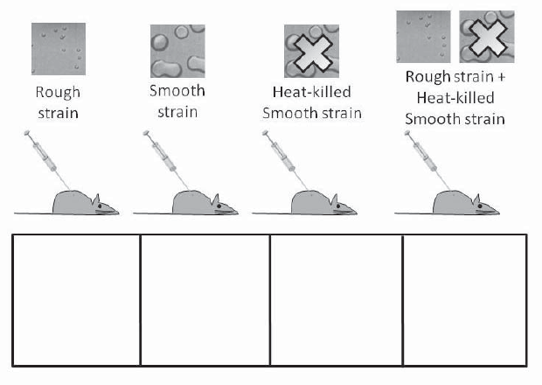
Griffith’s experiment: design
Griffith used mice as his species for detecting the pathogenicity of the bacteria. Injecting mice with bacteria grown on Petri plates either made the mice sick and killed them, or produced no disease.
Predict what will happen as a result of each injection (mice live or mice die).

Slide 11
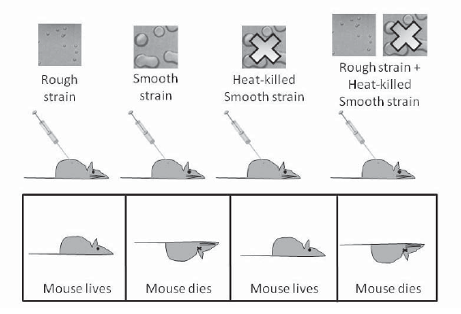
Griffith’s experiment: results
1. Which of the four treatments are controls? Explain your answer.
2. Which of the results is unexpected?
3. What are two hypotheses that might explain the unexpected result? In other words, what might be going on in the system?

Slide 12
Friedrich Miescher (1869)
In 1869, Friedrich Miescher isolated "nuclein," DNA with associated proteins, from cell nuclei. He was the first to identify DNA as a distinct molecule.
As a student, Miescher was given the task of researching the composition of lymphoid cells — white blood cells. These cells were difficult to extract from the lymph glands, but they were found in great quantities in the pus from infections. Miescher collected bandages from a nearby clinic and washed off the pus. He experimented and isolated a new molecule – nuclein – from the cell nucleus. He determined that nuclein was made up of hydrogen, oxygen, nitrogen and phosphorus and there was a unique ratio of phosphorus to nitrogen.

Slide 13
Oswald Avery, Colin MacLeod, Maclyn McCarty (1944): Griffith’s experiment revised
In 1944, three Canadian and American researchers, Oswald Avery, Maclyn McCarty, and Colin MacLeod set out to identify Griffith's "transforming principle."

Slide 14
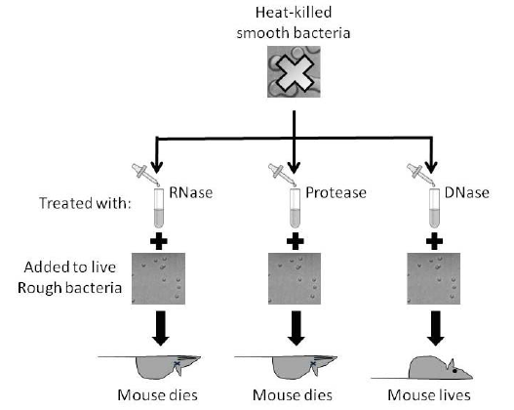
Avery’s experiment: results
What conclusion can be drawn from these data?

Slide 15
Alfred Hershey, Martha Chase (1952)
Bacteriophage T4 attaches to its bacterial host and injects its DNA to initiate an infection that ultimately releases hundreds of progeny virus. In 1952, Alfred Hershey and Martha Chase
(1) radiolabeled the DNA of bacteriophage T4 with ³²PO₄^{3–} and the proteins with ³⁵S-methionine.
(2) mixed the labeled bacteriophage with bacteria and after a brief time agitated the mixture vigorously in a blender to detach T4 from the bacteria.
(3) separated the phage from the bacteria by centrifugation.
(4) demonstrated that the bacteria contained 30% of the ³²P label but virtually none of the ³⁵S label. When new bacteriophage were released from these bacteria, they were also found to contain ³²P but no ³⁵S.
How does this experiment demonstrate that DNA rather than protein is the genetic material? (Note that bacteriophage T4 contains only protein and DNA.)
Notes:
Wilson, 4-17.

Slide 16
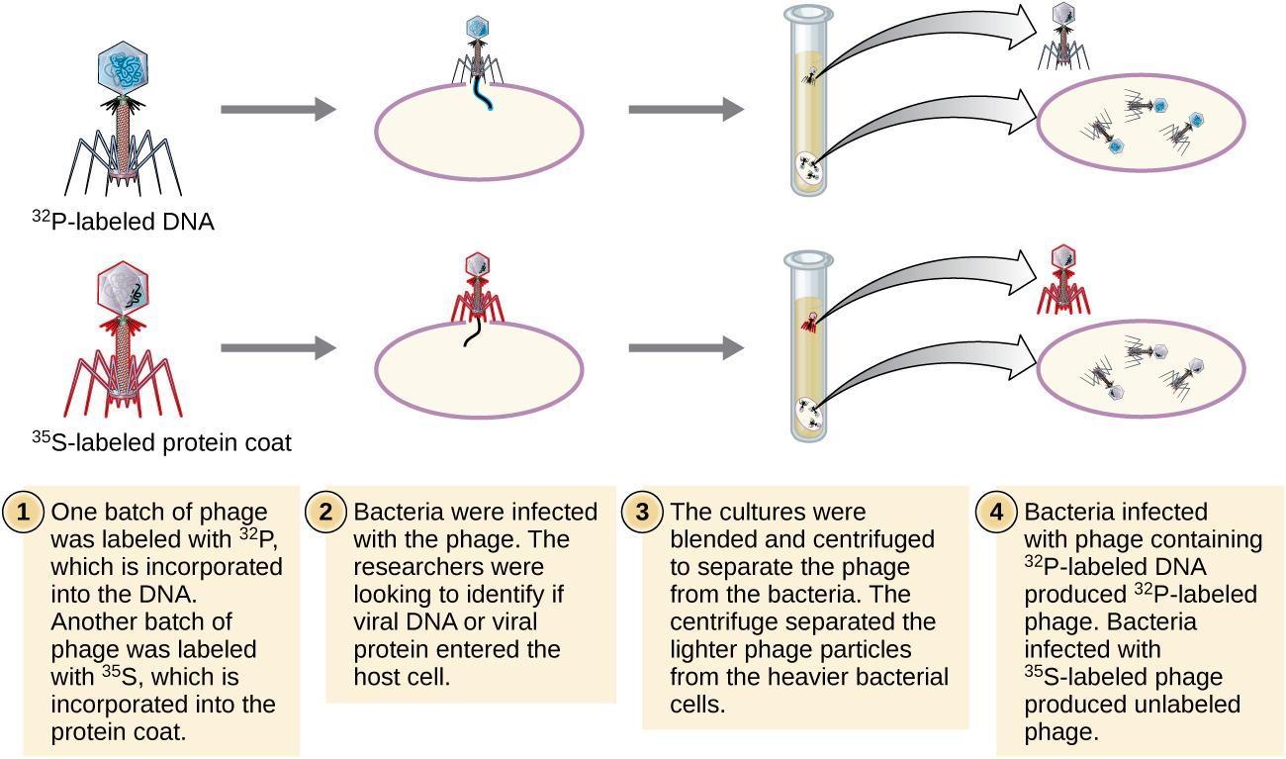

Slide 17
Erwin Chargaff (1949)
Chargaff analyzed the DNA of different species, determining its composition of A, T, C, and G bases. He made several key observations:
A, T, C, and G were not found in equal quantities (as some models at the time would have predicted)
The amounts of the bases varied among species, but not between individuals of the same species
The amount of A always equalled the amount of T, and the amount of C always equalled the amount of G (A = T and G = C)
These findings, called Chargaff's rules, turned out to be crucial to Watson and Crick's model of the DNA double helix.

Slide 18
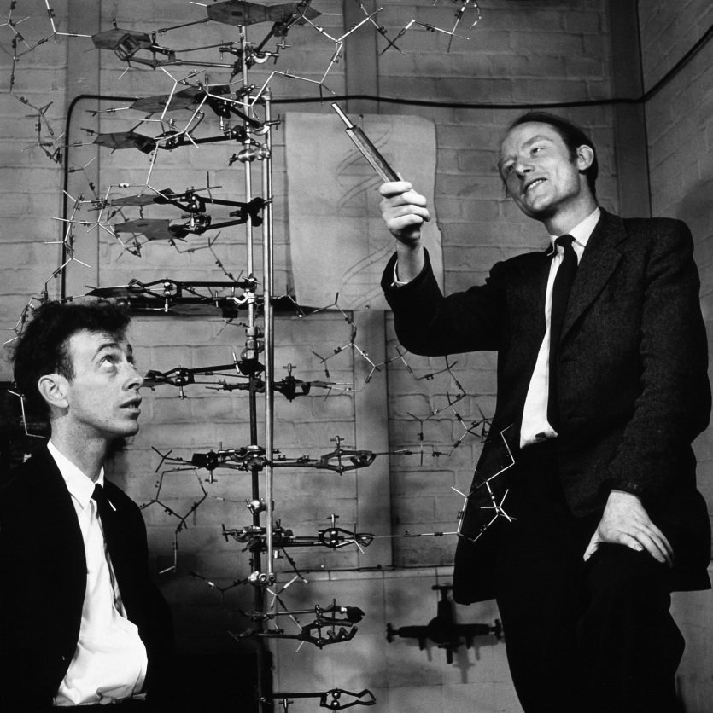
James Watson, Francis Crick
In the early 1950s, Watson and Crick mostly collected and analyzed existing pieces of data, putting them together in new and insightful ways. Some of their most crucial clues to DNA's structure came from X-ray crystallography.

Slide 19
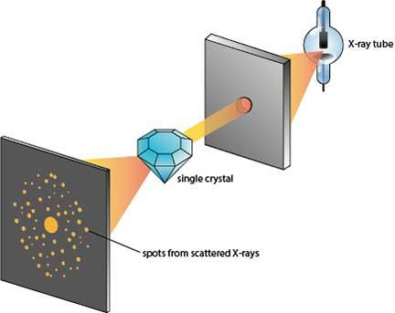
X-ray diffraction
X-ray diffraction is the elastic scattering of x-ray photons by atoms in a periodic lattice.
The technique relies on the dual wave/particle nature of X-rays to obtain information about the structure of crystalline materials. A primary use of the technique is the identification and characterization of compounds based on their diffraction pattern.

Slide 20
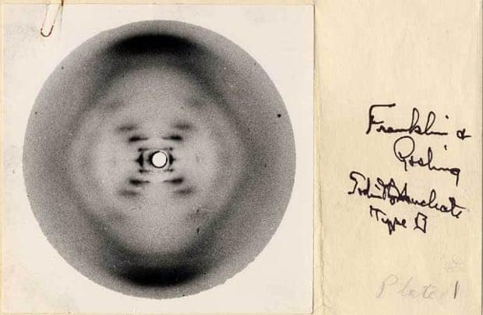
Rosalind Franklin: photo 51
Franklin was an expert in a powerful technique for determining the structure of molecules, known as X-ray crystallography.
When the crystallized form of a DNA is exposed to X-rays, some of the rays are deflected by the atoms in the crystal, forming a diffraction pattern that gives clues about the molecule's structure.

Slide 21
George Beadle, E. L. Tatum (1941)
The one gene, one enzyme hypothesis is the idea that each gene encodes a single enzyme. Today, we know that this idea is generally (but not exactly) correct.
Sir Archibald Garrod, a British medical doctor, was the first to suggest that genes were connected to enzymes.
Beadle and Tatum confirmed Garrod's hypothesis using genetic and biochemical studies of the bread mold Neurospora.
Beadle and Tatum identified bread mold mutants that were unable to make specific amino acids. In each one, a mutation had "broken" an enzyme needed to build a certain amino acid.

Slide 22
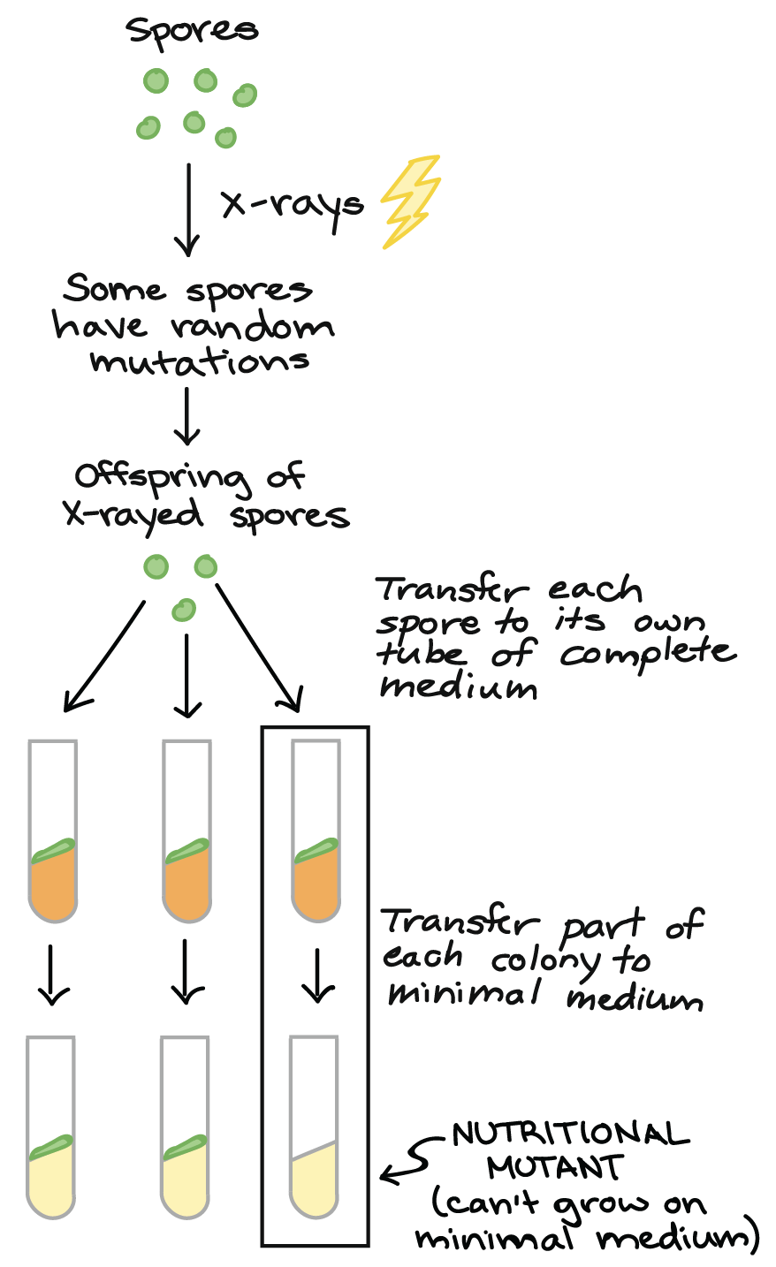
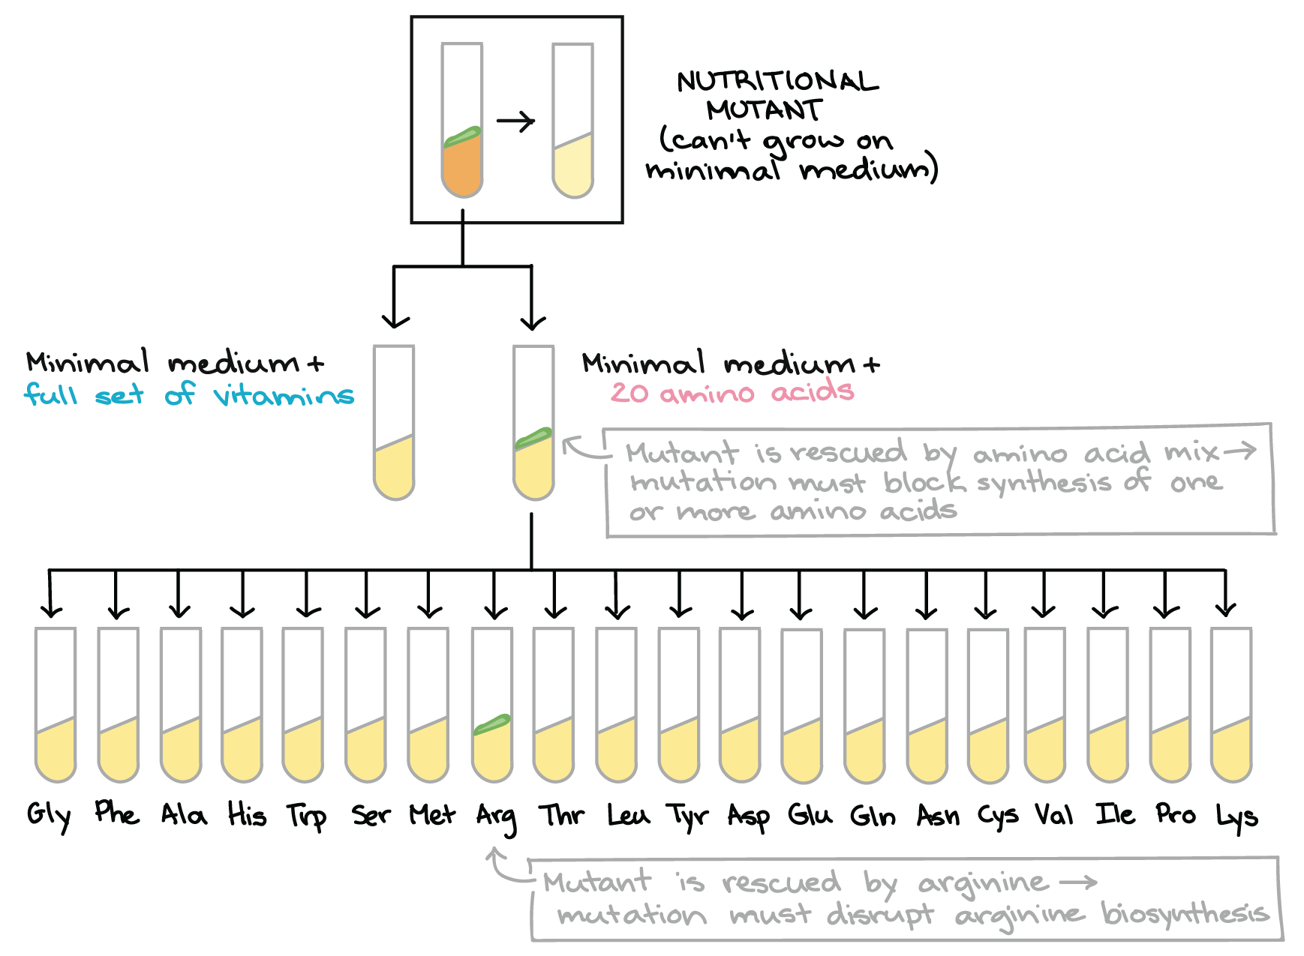
George Beadle, E. L. Tatum (1941)

Slide 23
Sydney Brenner, François Jacob,
Matthew Meselson (1961)
In 1961 South African molecular biologist Sydney Brenner working at the Cavendish Laboratory in Cambridge, French molecular biologist François Jacob at the Institut Pasteur in Paris, and American molecular biologist Matthew Meselson at Caltech in Pasadena. They showed that short-lived RNA molecules that they called messenger RNA (mRNA) carry the genetic instructions from DNA to structures in the cell called ribosomes. They also demonstrated that ribosomes are the site of protein synthesis.

Slide 24
Marshall Nirenberg, Gobind Khorana (1966)
In 1961 Nirenberg and his group deciphered the entire genetic code by matching amino acids to synthetic triplet nucleotides. They found that there is abundance in that some amino acids are encoded by more than one codon and some codons are "punctuation marks" in the mRNA message. Nirenberg and his group also showed that with few exceptions, the genetic code was universal to all life on earth. Nirenberg shared the 1968 Nobel Prize in Physiology and Medicine with Har Gobind Khorana and Robert Holley. Khorana also worked on cracking the genetic code; Holley was the first that deciphered the sequence of tRNA and determined its structure.

Slide 25
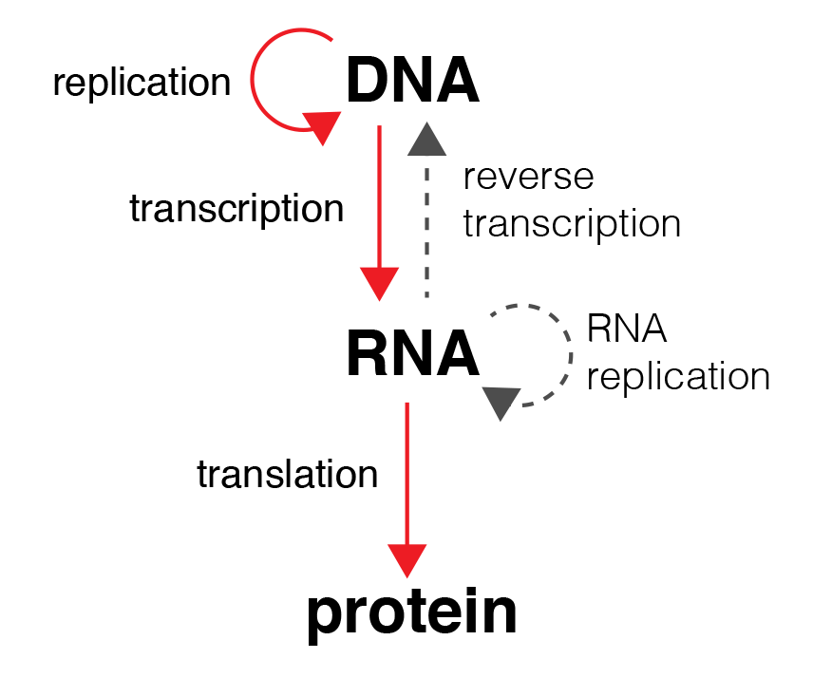
The central dogma of molecular biology

Slide 26
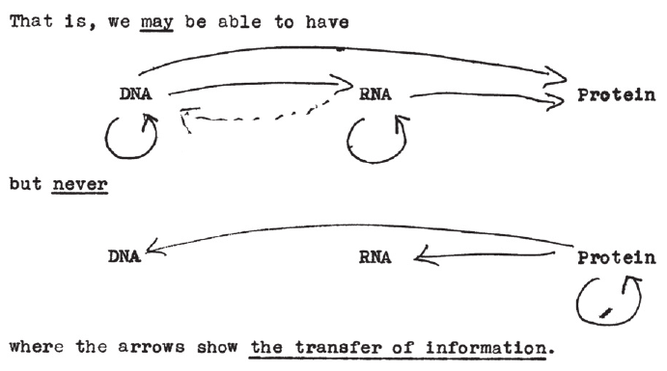
The central dogma of molecular biology
Francis Crick’s unpublished 1956 sketch.

Slide 27
The role of molecular biology in medicine
Molecular biotechnology:
microbiological synthesis of medical drugs and nutritional additives
production of vaccines
genetic engineering
Molecular medicine:
molecular diagnostics (ELISA, PCR, electrophoresis, restriction analysis and etc.)
gene therapy in vivo and ex vivo, genome editing and etc.
nanotechnologies and biocompatible materials in medicine

Slide 28
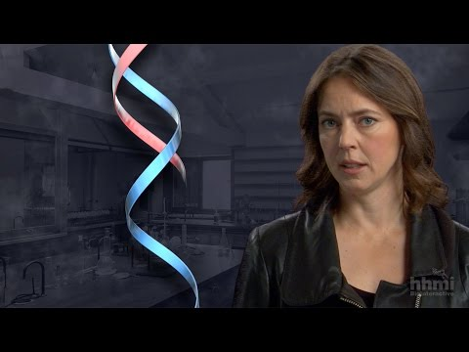
Video: DNA double helix
Notes:
Pre-class home assignment!

Slide 29
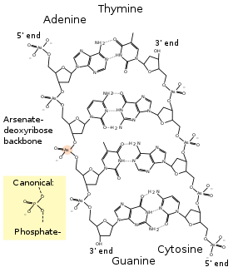
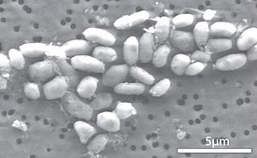
Case study
In 2010 F. Wolfe-Simon and J. Switzer Blum discovered bacteria Halomonas sp. GFAJ-1, that live in the lake Mono (state California, USA) with low concentration of phosphorus and high concentration of arsenicum. They claimed that this microorganism can substitute arsenate for phosphate in its DNA. After two years this hypothesis was refuted. How do you think, why this hypothesis was made and why it was refuted by other scientists?
Notes:
Soderberg, Timothy, "Organic Chemistry with a Biological Emphasis Volume II" (2016).Chemistry Publications. 2. - Chapter 9, pp. 1-4.

Slide 30
What are nucleic acids?
The 4th type of macromolecules
The chemical link between generations
The source of genetic information in chromosomes
Notes:
30

Slide 31
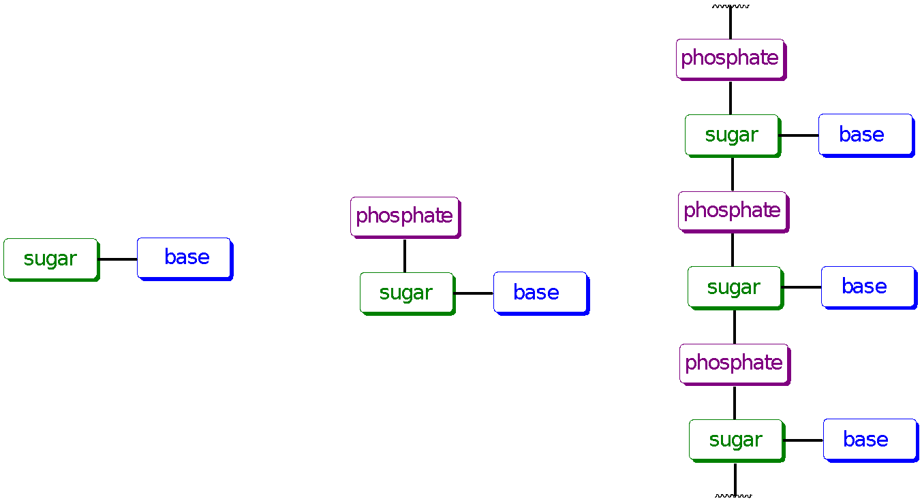
Nucleic Acids
deoxyribonucleic acid (DNA)
ribonucleic acid (RNA)
monomeric units for nucleic acids
=> nucleotides
Sugar: ribose in RNA, 2-deoxyribose in DNA
Heterocyclic base
Phosphate
nucleoside
nucleotides
nucleic acids
Notes:
Two major classes of nucleic acids
deoxyribonucleic acid (DNA): carrier of genetic information
ribonucleic acid (RNA): an intermediate in the expression of genetic information and other diverse roles
The monomeric units for nucleic acids are nucleotides
Nucleotides are made up of three structural subunits
1. Sugar: ribose in RNA, 2-deoxyribose in DNA
2. Heterocyclic base
3. Phosphate

Slide 32
A gene is a small region in the DNA.
Nucleic acids store and transmit hereditary information.
There are two types of nucleic acids:
1)- ribonucleic acid (RNA);
2)- deoxyribonucleic acid (DNA).
DNA also directs mRNA synthesis, thus, controls protein synthesis.
Organisms inherit DNA from their parents.
Each DNA molecule is very long and usually consists of hundreds to thousands of genes.
When a cell divides its DNA is copied and passed to the next generation of cells.
The mRNA interacts with ribosomes to direct the synthesis of amino acids in a polypeptide (protein)

Slide 33
What are they made of ?
Simple units called nucleotides, connected in long chains
Nucleotides have 3 parts:
1- 5-Carbon sugar (pentose)
2- Nitrogen containing base
(made of C, H and N)
3- A phosphate group ( P )
The P groups make the links that unite the sugars (hence a “sugar-phosphate backbone”
Notes:
33

Slide 34
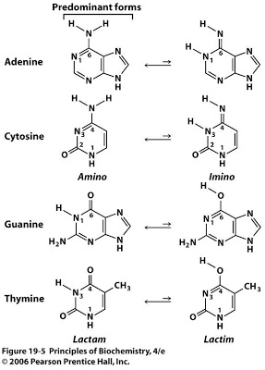
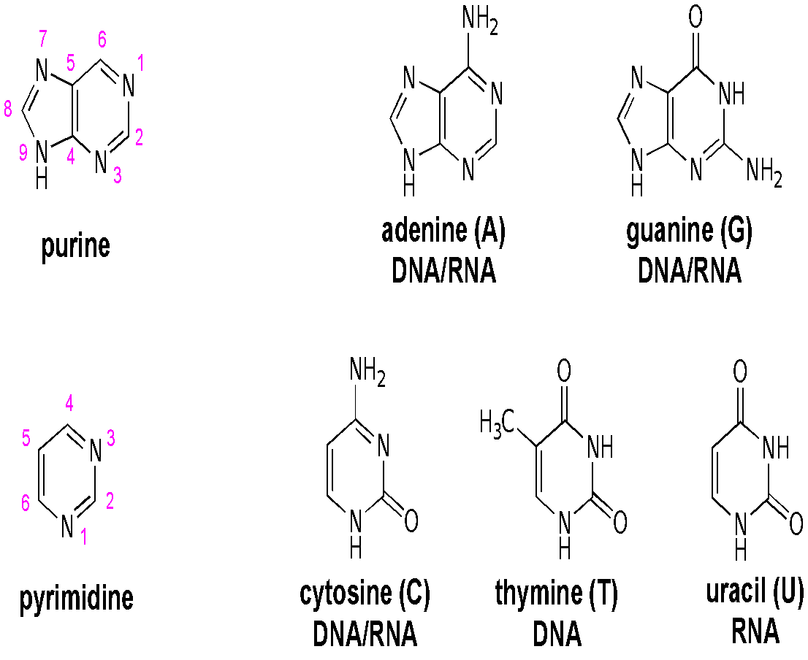
Heterocyclic bases
Notes:
The heterocyclic base; there are five common bases for nucleic acids
Keto-enol tautomerism
Acid/base dissociations
Strong absorbance of UV light

Slide 35
Nucleosides
heterocyclic base
carbohydrate
glycosidic bond
Notes:
Nucleosides = carbohydrate + base ribonucleosides or 2’-deoxyribonucleosides via a glycosidic bond
The carbon of the glycosidic bond is anomeric
Named by adding -idine to the root name of a pyrimidine or -osine to the root name of a purine
Conformation can be syn or anti
Sugars make nucleosides more water-soluble than free bases
To differentiate the atoms of the carbohydrate from the base, the position number of the carbohydrate is followed by a ´ (prime).
The stereochemistry of the glycosidic bond found in nucleic acids is β.

Slide 36
Nucleotides
nucleoside
phosphate
Notes:
Nucleotides. Phosphoric acid esters of nucleosides.
"Nucleotide phosphate" is redundant!
Most nucleotides are ribonucleotides
Nucleotides are polyprotic acids

Slide 37
DNA RNA
o
CH₂
o
CH₂
H
H
H
H
H
H
H
H
H
OH
Deoxyribose sugar (O on C2 is missed)
Ribose sugar (no missed O)
Deoxiribo-Nucleic-Acid
Ribo-Nucleic-Acid
Double stranded nucleic acid
Single stranded nucleic acid
Bases: A, G, C, T
Bases: A, G, C, U

Slide 38
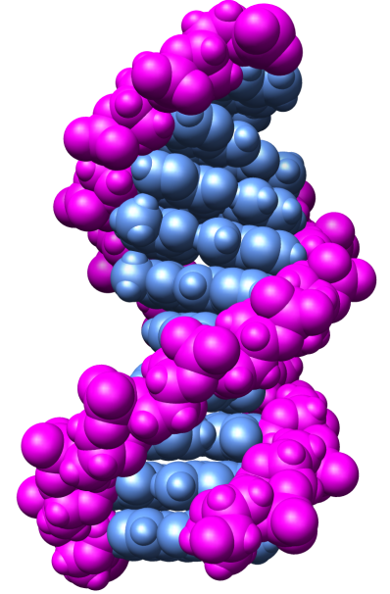
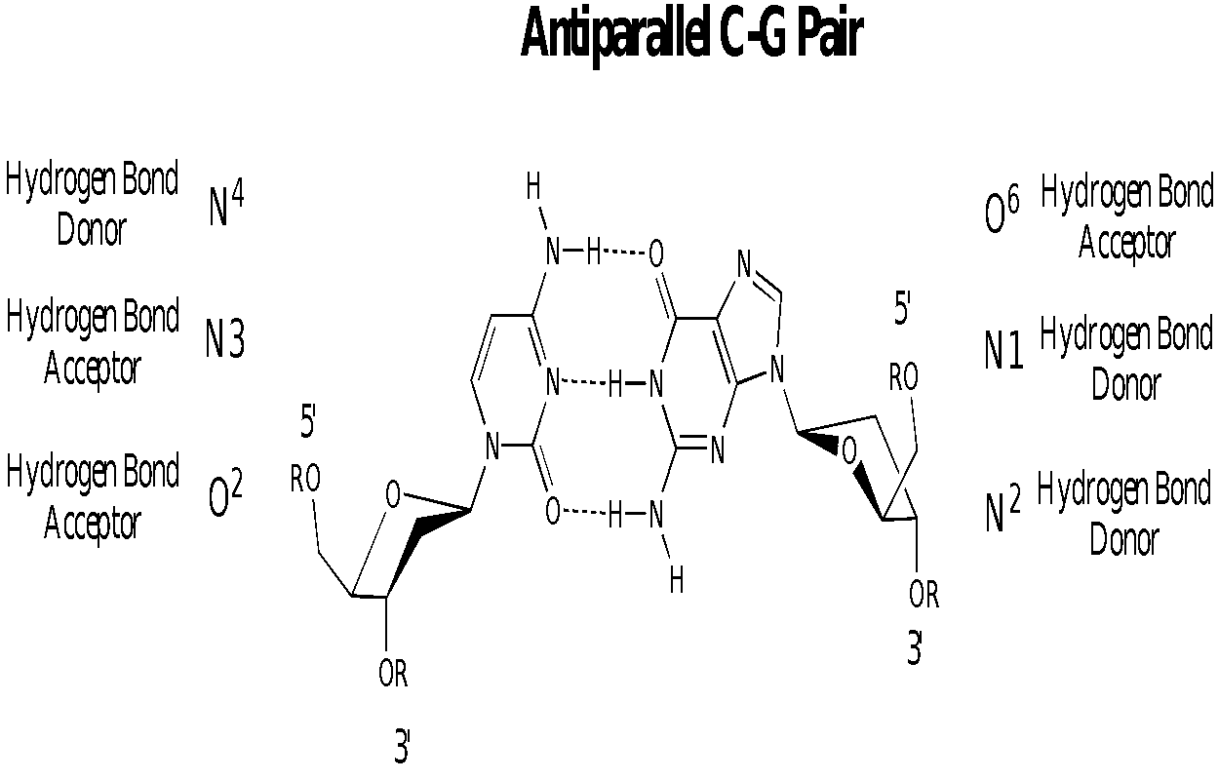
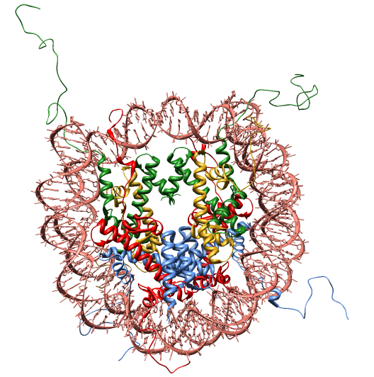
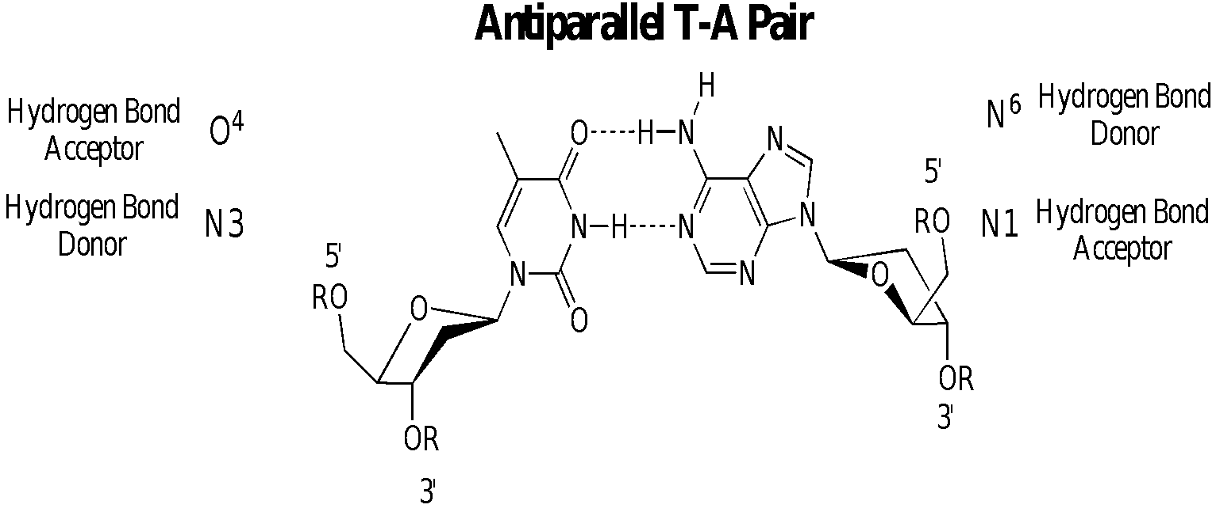
DNA
major
groove
12 Å
one
helical
turn
34 Å
minor
groove
6 Å
Notes:
Two polynucleotide strands, running in opposite directions (anti-parallel) and coiled around each other in a double helix.
The strands are held together by complementary hydrogen- bonding between specific pairs of bases.
Each cell contains about two meters of DNA. DNA is “packaged” by coiling around a core of proteins known as histones. The DNA-histone assembly is called a nucleosome. Histones are rich is lysine and arginine residues.
An antiparallel double helix
Diameter of 2 nm
Length of 1.6 million nm (E. coli)
Compact and folded (E. coli cell is only 2000 nm long)
Eukaryotic DNA wrapped around histone proteins to form nucleosomes
Base pairs: A-T, G-C

Slide 39
How DNA Works
1- DNA stores genetic information in segments called genes
2- The DNA code is in Triplet Codons (short sequences of 3 nucleotides each)
3- Certain codons are translated by the cell into certain Amino acids.
4. Thus, the sequence of nucleotides in DNA indicate a sequence of Amino acids in a protein.

Slide 40
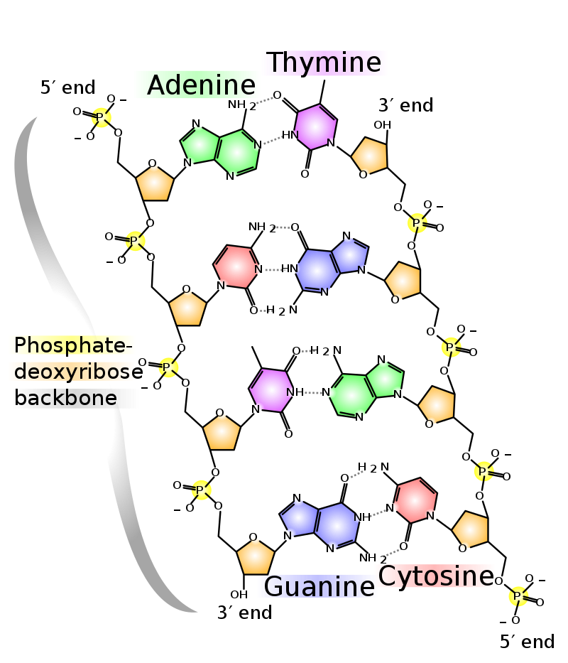
The PO₄ group of one nucleotide is attached to the sugar of the next nucleotide in line.
The result is a “backbone” of alternating phosphates and sugars, from which the bases starts.
Notes:
40

Slide 41
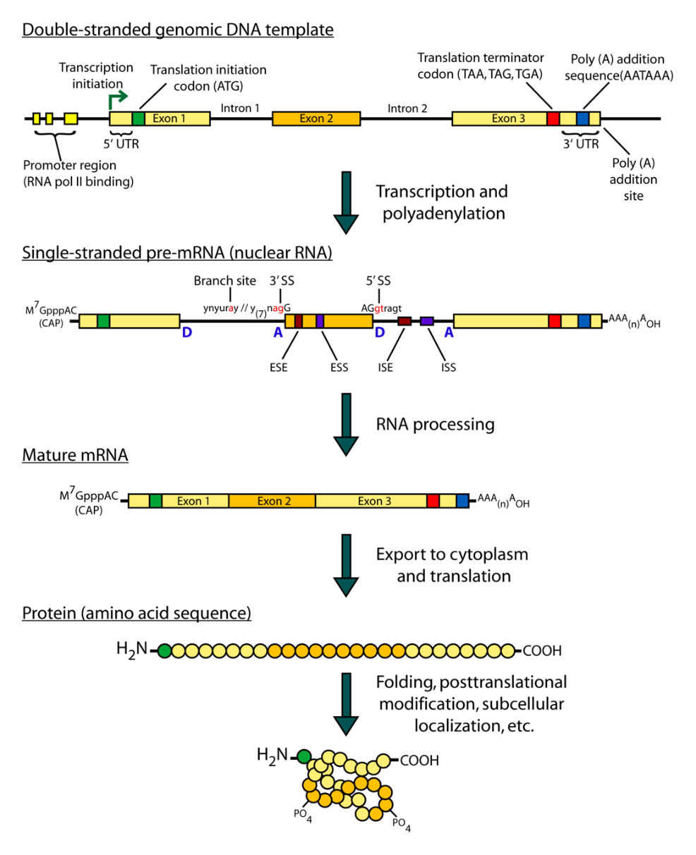
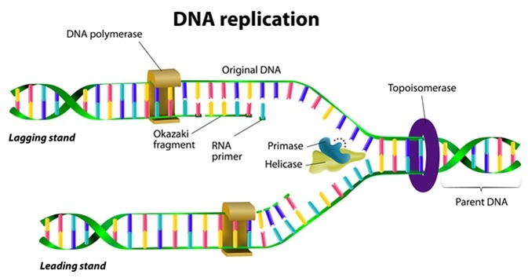
The Central Dogma (F. Crick):
DNA ^{replication} DNA ^{transcription} mRNA ^{translation} Protein
(genome) (transcriptome) (proteome)
Notes:
Replication: process by which DNA is copied with very high
fidelity.
Transcription: process by which the DNA genetic code is read
and transferred to messenger RNA (mRNA). This is an
intermediate step in protein expression
Translation: The process by which the genetic code is converted
to a protein, the end product of gene expression.

Slide 42
The nucleic acid strand is a polymer of nucleotides
Nucleic acids are polymers of monomers called nucleotides.
Each nucleotide consists of three parts: a nitrogen base, a pentose sugar, and a phosphate group.
The nitrogen bases (rings of carbon and nitrogen) come in two types: Purines and Pyrimidines.
The pentose sugar joined to the nitrogen base is ribose in nucleotides of RNA and deoxyribose in DNA.
The only difference between the sugars is the lack of an oxygen atom on carbon 2 in deoxyribose.

Slide 43
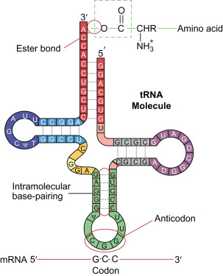
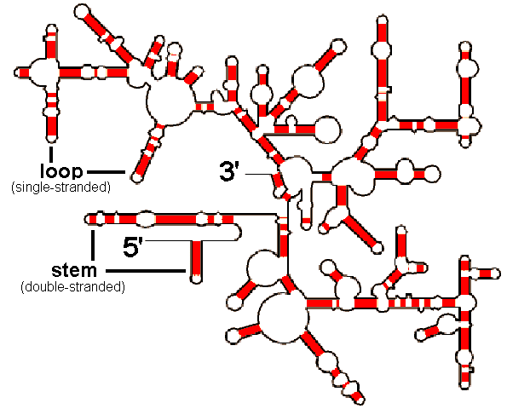
Main types of RNAs
Messenger RNA (mRNA)
Ribosomal RNA (rRNA)
Transfer RNA (tRNA)

Slide 45
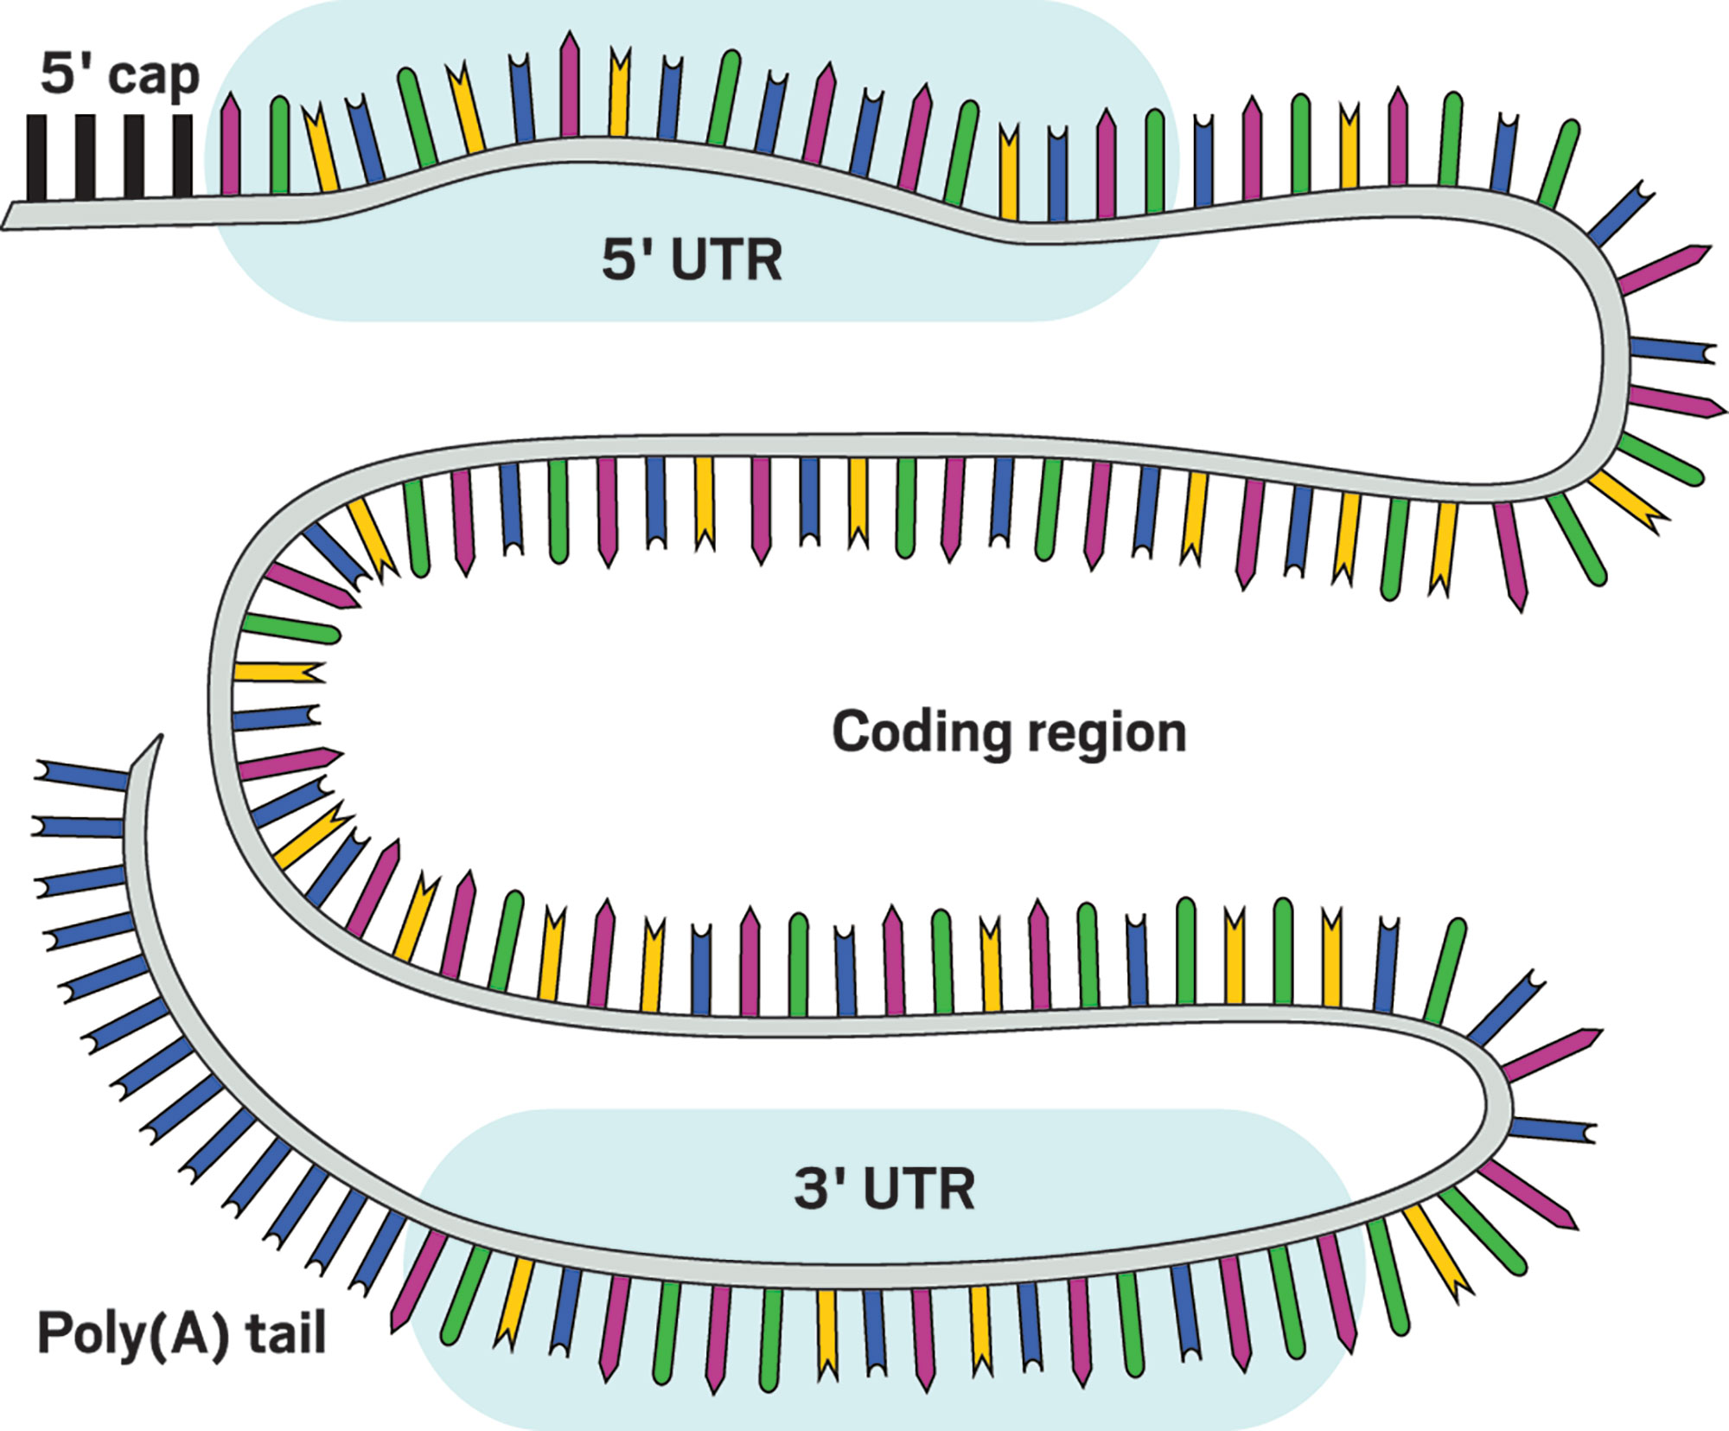
Messenger RNA

Slide 46
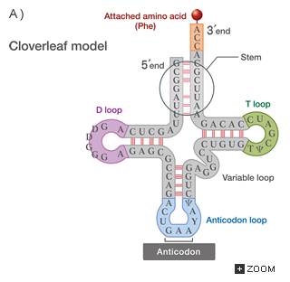
Transfer RNA
Length – 76-90 nucleotides
Structure – stem-loop (cloverleaf)
Function – transfer of amino acids in accordance with genetic code during the protein synthesis

Slide 47
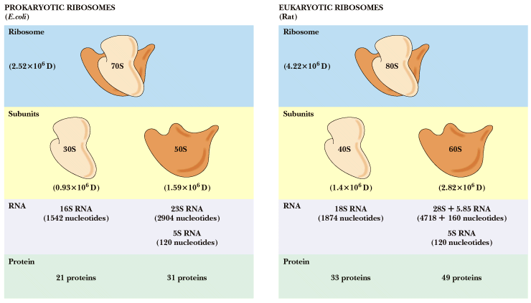
Ribosomes and ribosomal RNAs
Notes:
Eukaryotic mRNA
DNA is transcribed to produce heterogeneous nuclear RNA
mixed introns and exons with poly A
intron - intervening sequence
exon - coding sequence
poly A tail - stability?
Splicing produces final mRNA without introns
Ribosomal RNA
Ribosomes are about 2/3 RNA, 1/3 protein
rRNA serves as a scaffold for ribosomal proteins
23S rRNA in E. coli is the peptidyl transferase!

Slide 48
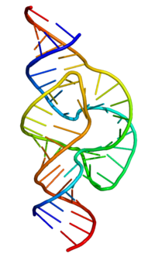
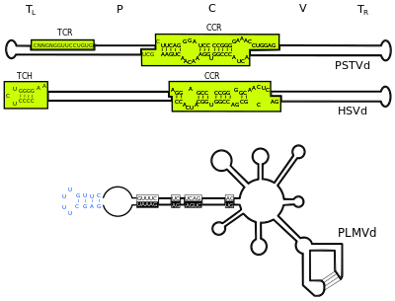
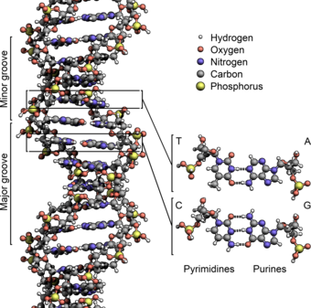
Question.
Why in many living organisms (with exception of some viruses) only DNA, but not RNA, is the main source of genetic information?

